Slide 1


Welcome to Year 6’s
Meet the Teacher
Notes:
Thank-you for coming. Please make sure to tick off your child’s name and take an information pack so we know which children need information packs sent home tomorrow. Thankyou

Slide 2
Meet the Year 6 Team
Teacher | Teaching Assistants
Mr Correa | Mrs Kennedy Mrs Florkova
Notes:
Here is some key year 4 information. The year ____ staff consist of me, ________ as the full time class teacher. ____________ and _________ are our teaching assistants in the ___________.

Slide 3
Key Information
Registration | Lesson 1 | Lesson 2 | Break | Lesson 3 | Lunch | Lesson 4 | Lesson 5 | End of the day
8:45am Soft start | Guided Reading/Spelling | Maths | 10:30-10:45am | English | 12-1pm | RE | P.E. | End of day prayer 3:15pm
PE Days | Forest School
Tuesdays and Fridays | Once a half term
Notes:
This is an overview of our school times throughout the day and here is an example timetable, as you can see – school days are very busy so it is no surprise very tired children come home! Our PE days this halfterm are _____________.
Forest School halfterm _______
Swimming term ____________

Slide 4
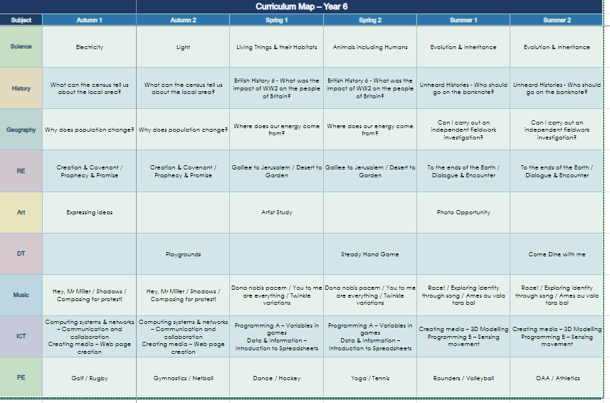
Curriculum
Notes:
Here is an overview of things we will be studying in class this term Autumn 1 term.
If you want to know for the following terms, please check our subject curriculum map overviews on the school website.

Slide 5
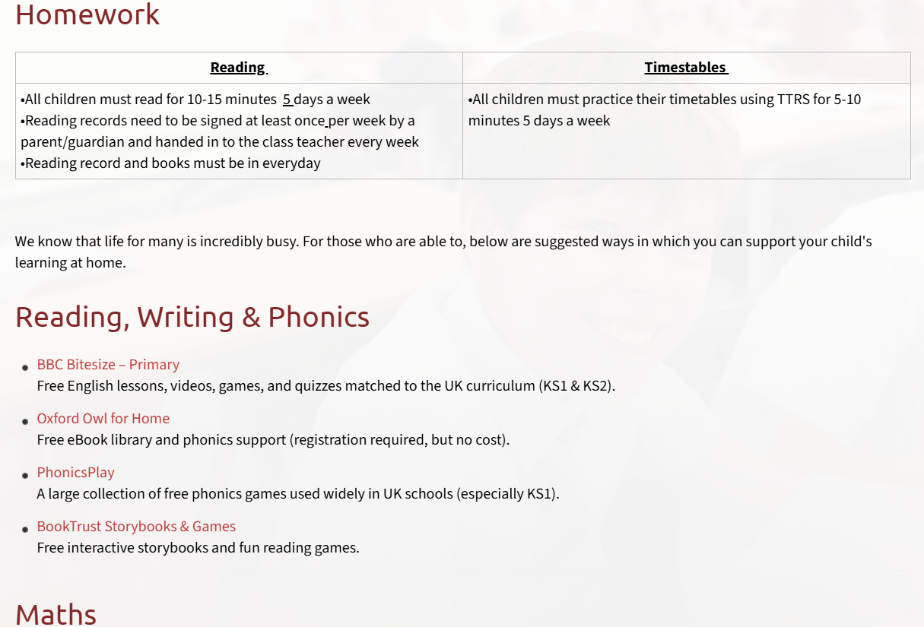
Homework
Reading | Timestables
All children must read for 10-15 minutes 5 days a week Reading records need to be signed at least once per week by a parent/guardian and handed in to the class teacher every week on ….. Reading record and books must be in everyday | All children must practice their timetables using TTRS for 5-10 minutes 5 days a week (as necessary). Maths Tasks
Please refer to the school website ‘Learning Resources’ page for examples of websites for further homework support
Notes:
Decide on a day to hand in reading records each week and add
Use reading record as a example
Sign post to website for more examples of homework websites

Slide 6

Enrichment opportunities
- Special Friends
- Sporting Events
- PGL Residential Trip
Notes:
Enrichment in Year _____ is………………….
Trips, competitions etc..that you know ARE happening. – E.G. Y5& 6 RESIDENTIAL,

Slide 7
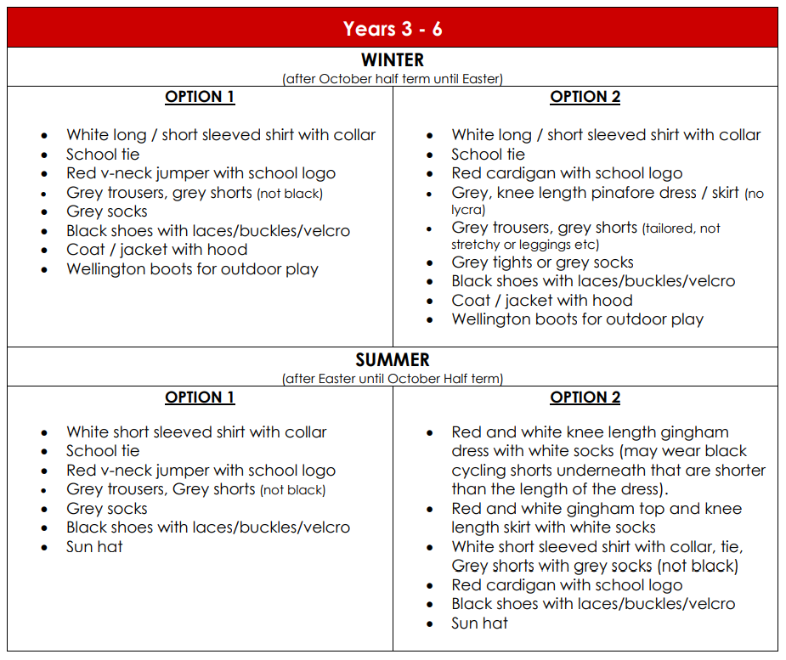
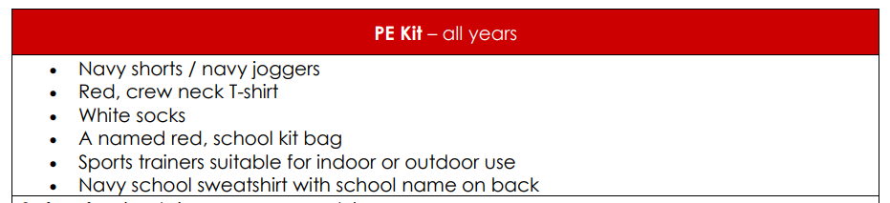
Uniform
Please refer to the school website for more information on school uniform.
Notes:
In year ________ we wear _________
PE kits consist of ______

Slide 8

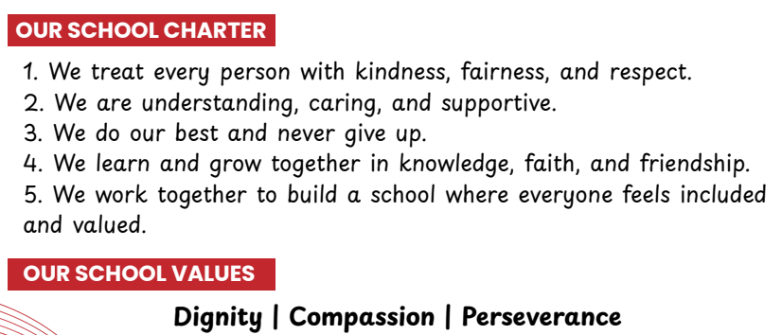
School mission and values
‘Learning to love, live and celebrate as we grow in the knowledge and love of Christ.’
Prayers to reinforce at home:
Our Father, Hail Mary, Glory Be, responses and key prayers used in Mass (Gloria, Creed etc.)
Notes:
Our mission statement – at the heart of what we endeavour to do. Showing the values we want the children to have
Treating others as we want to be treated
loving, respectful, kind, polite
Being honest
Forgiving one another
Supporting and valuing this at home
Reiterated in school through assemblies, class worship, regular links with local parishes to celebrate Mass, regular prayer.

Slide 9
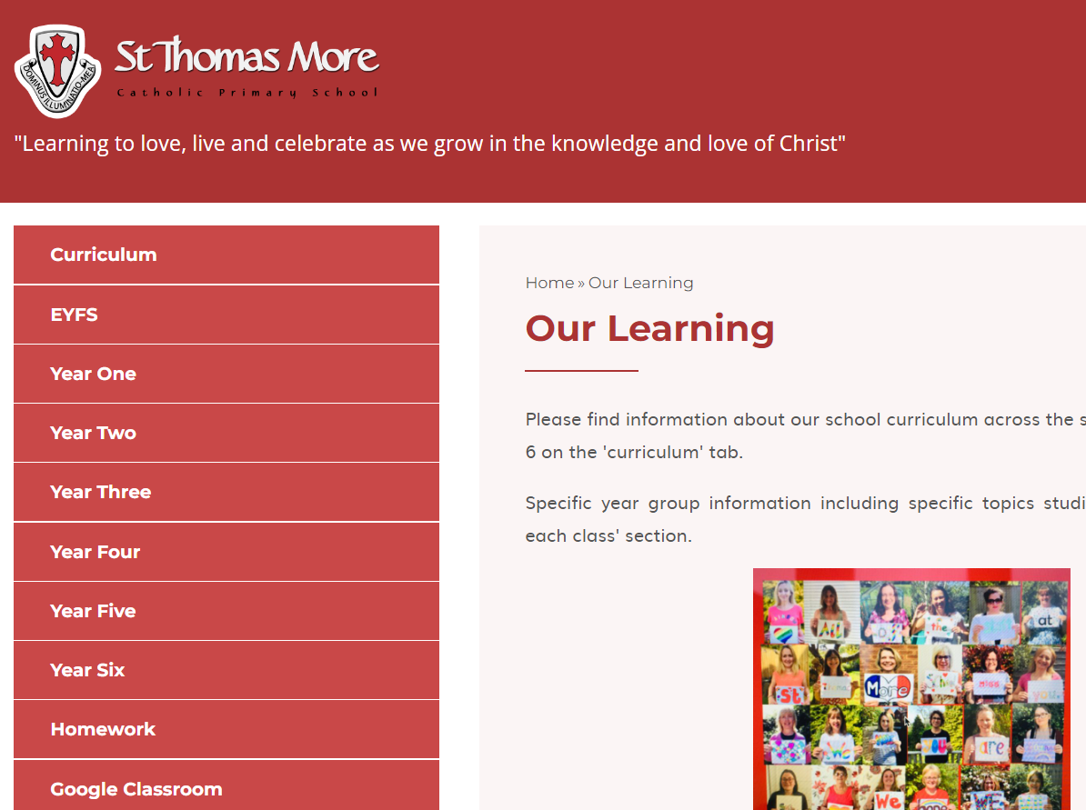
Year group class pages
Notes:
Show parents where they can find your class page on the website with overviews and class specific info should they need to refer back to it during the year

Slide 10
How to get in contact:
Email – admin@stmore.herts.sch.uk
Marvellous Me – General information, badges and achievements etc.
Drop off/pick up times
Upcoming Important Dates:
Parent Consultation evenings – 14th and 15th October 2026
Learning Showcase – 20th October from 3.30pm

Slide 11

Questions?
Feel free to ask now or speak to me afterwards

