Slide 1


Welcome to Year 2’s
Meet the Teacher
Notes:
Thank-you for coming. Please make sure to tick off your child’s name and take an information pack so we know which children need information packs sent home tomorrow. Thankyou

Slide 2
Meet the Year 2 Team
Teacher | Teaching Assistants
Miss Johnson | Mrs Trowbridge
Notes:
Here is some key year 4 information. The year ____ staff consist of me, ________ as the full time class teacher. ____________ and _________ are our teaching assistants in the ___________.

Slide 3
Key Information
Registration | Lesson 1 | Lesson 2 | Break | Lesson 3 | Lunch | Lesson 4 | Lesson 5 | End of the day
8:40am Soft start Morning activity | Guided Reading/Spellings | English | 10:30-10:45am | Maths | 12-1pm | RE | Science | Story/end of day prayer 3:15pm
PE Days | Forest School
Monday Wednesday | Mondays: 14th Sept 25th Jan 15th March 17th May 14th June
Notes:
This is an overview of our school times throughout the day and here is an example timetable, as you can see – school days are very busy so it is no surprise very tired children come home! Our PE days this halfterm are _____________.
Forest School halfterm _______
Swimming term ____________

Slide 4
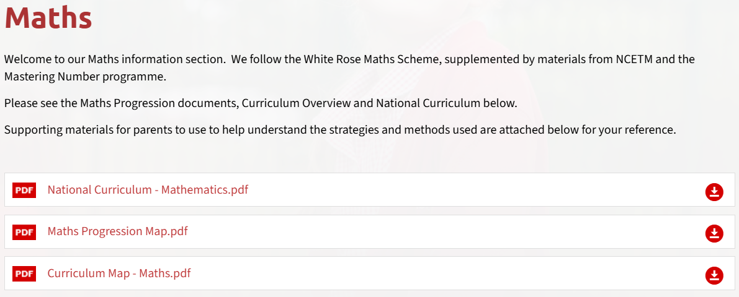
Curriculum
Subject area | Autumn 1 Topic
English | The Owl Who Was Afraid of the Dark Narrative writing
Maths | Place value
RE | Creation and covenant
Science | Animals including humans
History | How was school different in the past?
PE | Ball skills and fundamentals
Computing | Computing systems and networks- IT around us
Please check our subject curriculum maps for termly topics
E.g.
Notes:
Here is an overview of things we will be studying in class this term Autumn 1 term.
If you want to know for the following terms, please check our subject curriculum map overviews on the school website.

Slide 5

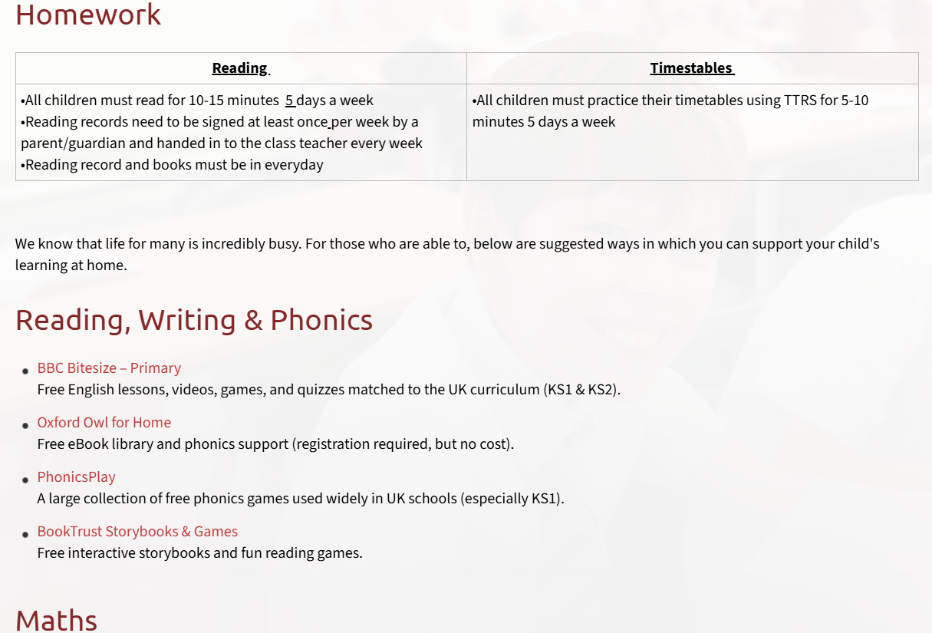
Homework
Reading | Timestables
All children must read for 10-15 minutes 5 days a week Reading records need to be signed at least once per week by a parent/guardian and handed in to the class teacher every week on Thursday Reading record and books must be in everyday | All children must practice their timetables using TTRS for 5-10 minutes 5 days a week
Please refer to the school website ‘Learning Resources’ page for examples of websites for further homework support
Notes:
Decide on a day to hand in reading records each week and add
Use reading record as a example
Sign post to website for more examples of homework websites

Slide 6
Reading
1 independent and 2 shared books every week
Change books on a Thursday
Please remember to write in reading records
Notes:
Enrichment in Year _____ is………………….
Trips, competitions etc..that you know ARE happening. – E.G. Y5& 6 RESIDENTIAL,

Slide 7
Spellings
Just before half term- Bridge to Spelling units followed by spelling units
Children will receive weekly spellings- Thursday
Spelling quiz weekly- Thursday
Notes:
Enrichment in Year _____ is………………….
Trips, competitions etc..that you know ARE happening. – E.G. Y5& 6 RESIDENTIAL,

Slide 8

Enrichment opportunities
Christmas panto
School events- drama workshops
PE trips
Trips linked to topics
Notes:
Enrichment in Year _____ is………………….
Trips, competitions etc..that you know ARE happening. – E.G. Y5& 6 RESIDENTIAL,

Slide 9
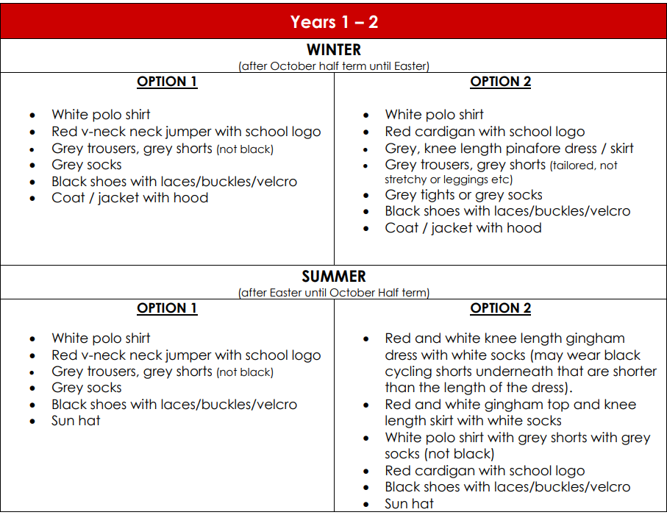
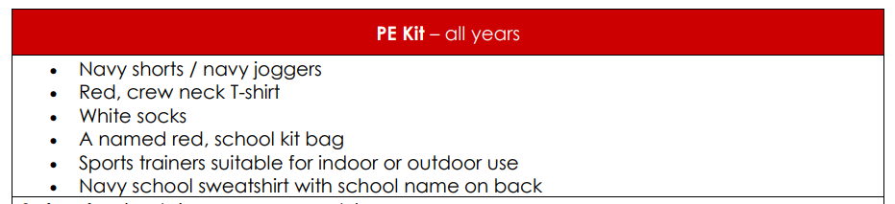
Uniform
Please refer to the school website for more information on school uniform.
Notes:
In year ________ we wear _________
PE kits consist of ______

Slide 10

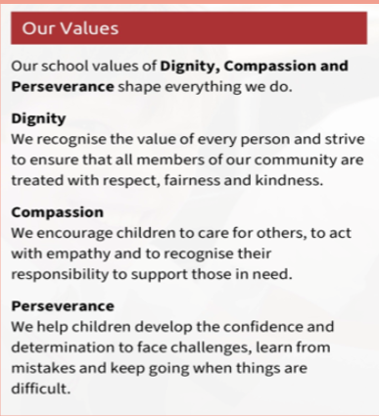
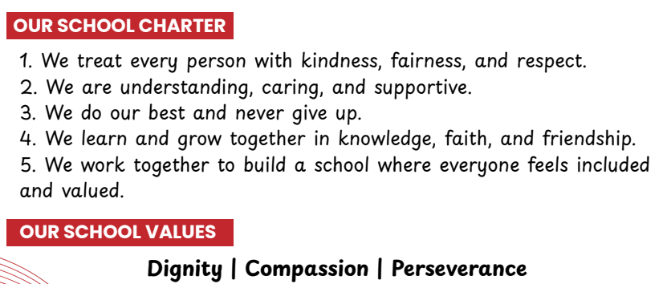
School mission and values
‘Learning to love, live and celebrate as we grow in the knowledge and love of Christ.’
Prayers to reinforce at home:
Our Father, Hail Mary, Glory Be, responses and key prayers used in Mass (Gloria, Creed etc.)
Notes:
Our mission statement – at the heart of what we endeavour to do. Showing the values we want the children to have
Treating others as we want to be treated
loving, respectful, kind, polite
Being honest
Forgiving one another
Supporting and valuing this at home
Reiterated in school through assemblies, class worship, regular links with local parishes to celebrate Mass, regular prayer.

Slide 11
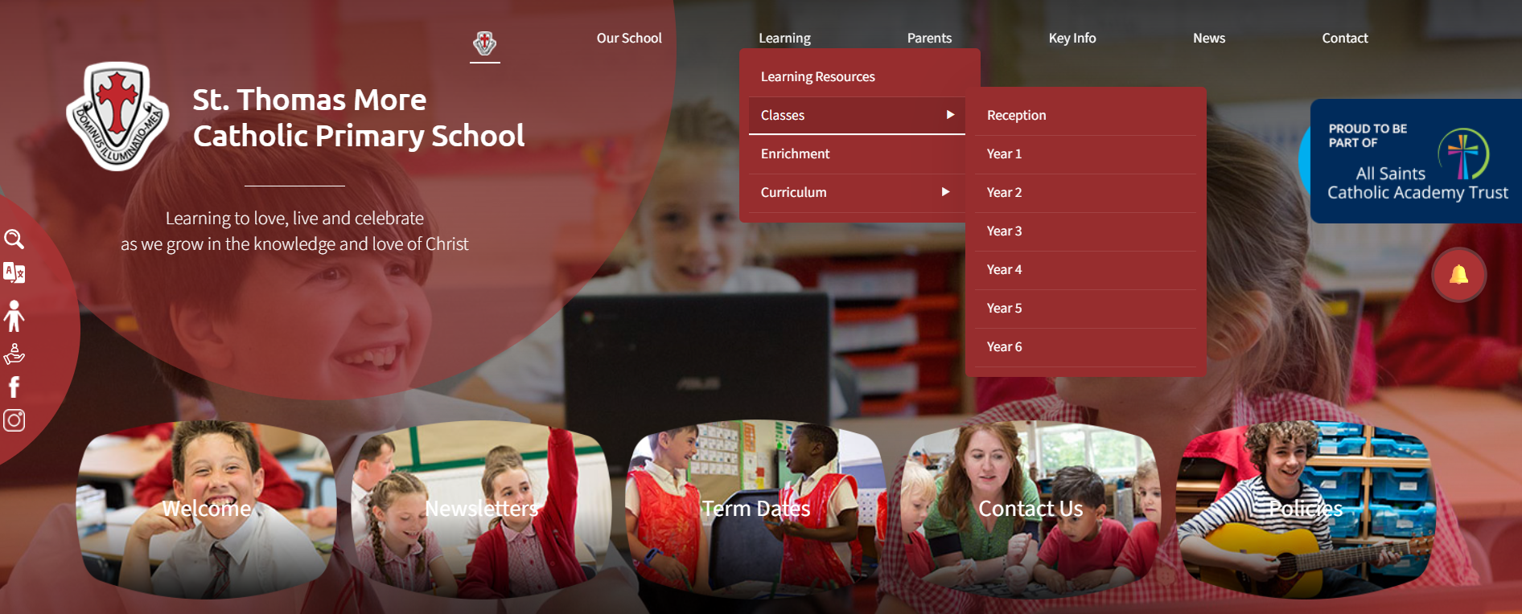
Year group class pages
Notes:
Show parents where they can find your class page on the website with overviews and class specific info should they need to refer back to it during the year

Slide 12
How to get in contact:
Email – admin@stmore.herts.sch.uk
Marvellous Me – General information, badges and achievements etc.
Upcoming Important Dates:
Parent Consultation evenings – Wednesday 14th and Thursday 15th October
Learning Showcase – Tuesday 20th October from 3.30pm

Slide 13

Questions?
Feel free to ask now or speak to me afterwards

