Slide 1


Welcome to Year 1’s
Meet the Teacher
Notes:
Thank-you for coming. Please make sure to tick off your child’s name and take an information pack so we know which children need information packs sent home tomorrow. Thank you

Slide 2
Meet the Year 1 Team
Teacher | Teaching Assistants
Ms Gabbitas | Mrs Ali Mrs Rodgers
Notes:
Here is some key year 1 information. The year ____ staff consist of me, ________ as the full time class teacher. ____________ and _________ are our teaching assistants in the ___________.

Slide 3
Key Information
Registration | Lesson 1 | Lesson 2 | Break | Lesson 3 | Lunch | Lesson 4 | Lesson 5 | End of the day
8:45am Soft start | Phonics | Maths Reading | 10:30-10:45am | English Handwriting | 12-1pm | Mastering Number Eg RE | Eg Science | Story/end of day prayer 3:15pm
PE Days | Forest School | Swimming
Wednesday Thursday | 1 session per half term | No
Notes:
This is an overview of our school times throughout the day and here is an example timetable, as you can see – school days are very busy so it is no surprise very tired children come home! Our PE days this halfterm are _____________.
Forest School halfterm _______
Swimming term ____________

Slide 4
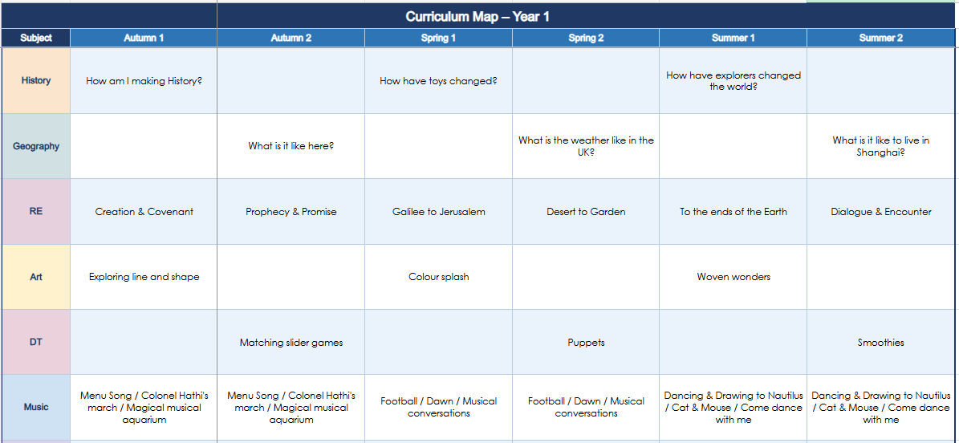
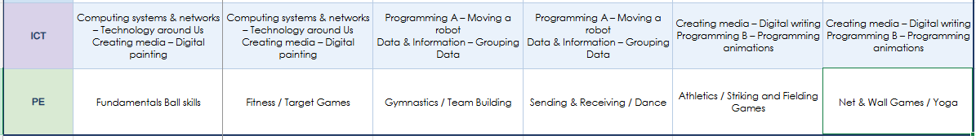
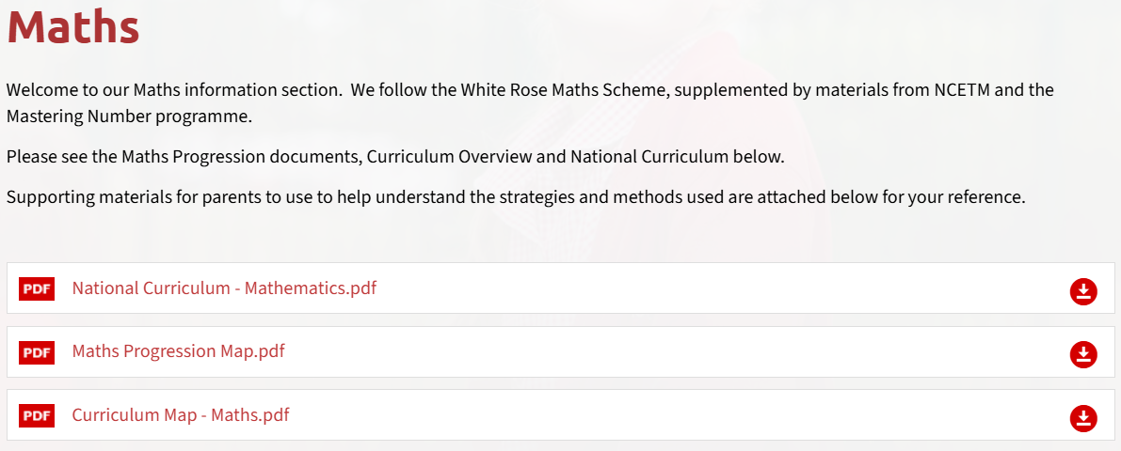
Curriculum
Subject area | Autumn 1 Topic
English & Phonics | Initial sounds and digraphs Sentence writing
Maths | Place value within 10 Addition and Subtraction within 10
RE | Creation & Covenant
Science | Animals including Humans
History | How am I making History
PE | Fundamentals Ball Skills
Computing | Computing systems and networks
Please check our subject curriculum maps for termly topics
E.g.
Notes:
Here is an overview of things we will be studying in class this term Autumn 1 term.
If you want to know for the following terms, please check our subject curriculum map overviews on the school website.

Slide 5
Reading
Shared Books, Independent books
Linked to Phonics
Repetition
Books in every day,
please sign reading records
Write in sharing books if you
would like
Notes:
Show parents where they can find your class page on the website with overviews and class specific info should they need to refer back to it during the year

Slide 6

Enrichment opportunities
School trips
Panto trip
PE events
Drama sessions in school
Notes:
Enrichment in Year _____ is………………….
Trips, competitions etc..that you know ARE happening. – E.G. Y5& 6 RESIDENTIAL,

Slide 7
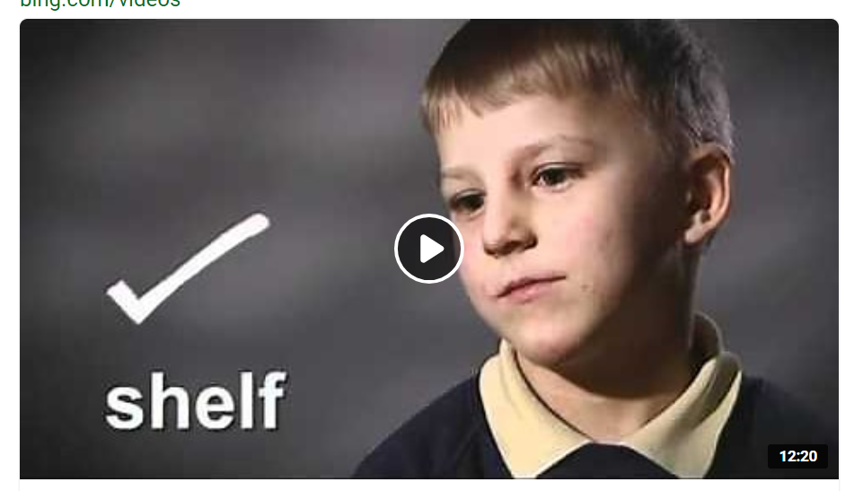
Year 1 Phonics Screening
This happens in June and is a Government requirement in which children are asked to read 20 real and 20 pseudo words, or alien words as they refer to them.
https://youtu.be/yC-y3PWVo6M
Notes:
Specific year group info
e.G
The purpose of the MTC is to determine whether pupils can recall their times tables fluently, which is essential for future success in mathematics. It will help schools to identify pupils who have not yet mastered their times tables, so that additional support can be provided.
Please check the following website for more information.

Slide 8
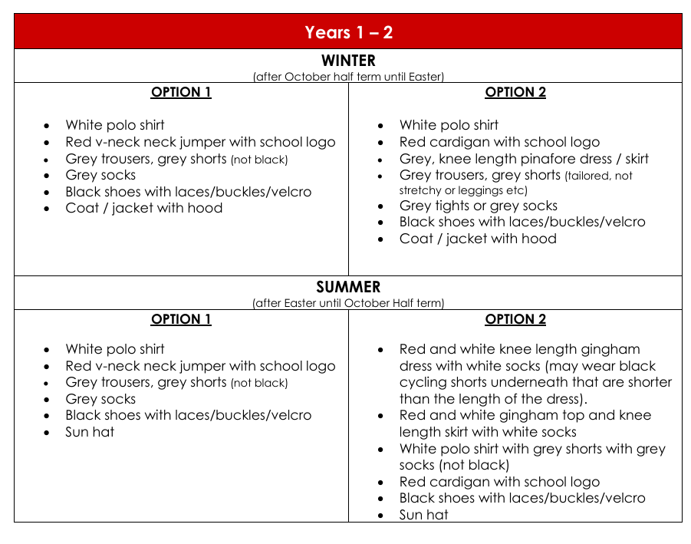
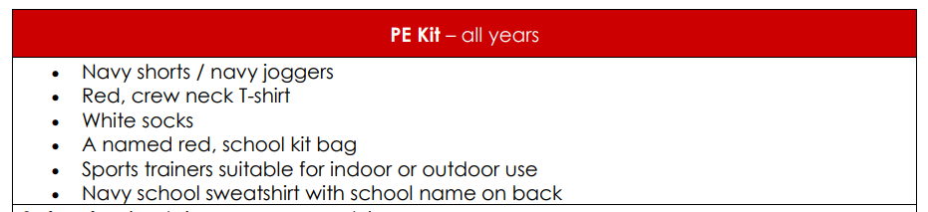
Uniform
Please refer to the school website for more information on school uniform.
PLEASE NAME EVERYTHING
Notes:
In year ________ we wear _________
PE kits consist of ______

Slide 9


School mission and values
‘Learning to love, live and celebrate as we grow in the knowledge and love of Christ.’
Prayers to reinforce at home:
Our Father, Hail Mary, Glory Be, responses and key prayers used in Mass (Gloria, Creed etc.)
Notes:
Our mission statement – at the heart of what we endeavour to do. Showing the values we want the children to have
Treating others as we want to be treated
loving, respectful, kind, polite
Being honest
Forgiving one another
Supporting and valuing this at home
Reiterated in school through assemblies, class worship, regular links with local parishes to celebrate Mass, regular prayer.

Slide 10
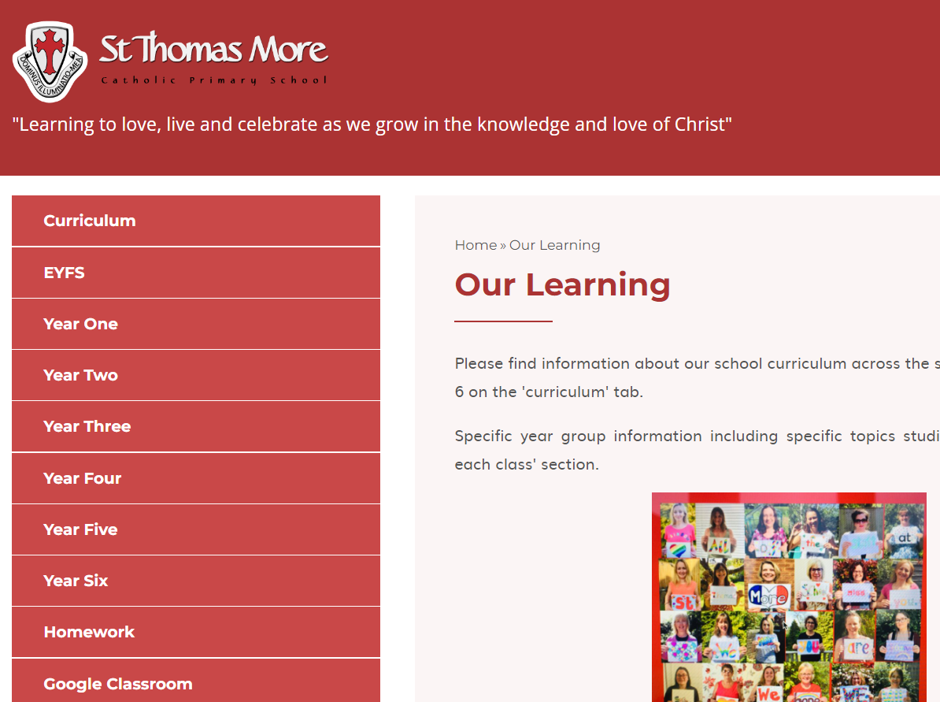
Year group class pages
Notes:
Show parents where they can find your class page on the website with overviews and class specific info should they need to refer back to it during the year

Slide 11
How to get in contact:
Email – admin@stmore.herts.sch.uk
Marvellous Me – General information, badges and achievements etc.
Drop off/pick up times
Upcoming Important Dates:
Parent Consultation evenings – 14th and 15th October
Learning Showcase – 20th October from 3.30pm

Slide 12

Questions?
Feel free to ask now or speak to me afterwards

