Slide 1


Welcome to Year 4’s
Meet the Teacher
Notes:
Thank-you for coming. Please make sure to tick off your child’s name and take an information pack so we know which children need information packs sent home tomorrow. Thankyou

Slide 2
Meet the Year 4 Team
Teacher | Teaching Assistants
Miss Carey | Mrs Harrison (Mon – Thurs AM) Mrs Trowbridge (Thurs and Fri AM)
Notes:
Here is some key year 4 information. The year ____ staff consist of me, ________ as the full time class teacher. ____________ and _________ are our teaching assistants in the ___________.

Slide 3
Key Information
Registration | Lesson 1 | Lesson 2 | Break | Lesson 3 | Lunch | Lesson 4 | Lesson 5 | End of the day
8:45am Soft start | Reading/Spelling (Monday) | English | 10:30-10:45am | Maths | 12-1pm | Science | French | Story/end of day prayer 3:15pm
PE Days | Forest School | Swimming
Tuesday afternoon Swimming on Thursday (Autumn term) | One Morning session each term. (First session is on the 28th September.) | Autumn term
Notes:
This is an overview of our school times throughout the day and here is an example timetable, as you can see – school days are very busy so it is no surprise very tired children come home! Our PE days this halfterm are _____________.
Forest School halfterm _______
Swimming term ____________

Slide 4
Curriculum
Subject area | Autumn | Spring | Summer
English | Charlie and the Chocolate Factory by Roald Dahl, Still I Rise by Maya Angelou, The Iron Man, Secrets of a Sun King, The Plague | Arthur and the Golden Rope, International Women's Day Speech, Princess and the Pea, Once Upon a Raindrop | The Boy the Mole the Fox and the Horse, Should We Feed Animals in National Parks, The Great Choco-Plot, An Alternative to Plastic Straws
Maths | Place Value, Addition and Subtraction, Measurement, Multiplication and Division | Multiplication and division, Length and Perimeter, Fractions, Decimals | Decimals, Money, Time, Shape, Statistics, Position and Direction
RE | Branch 1 – Creation and Covenant Branch 2 – Prophecy and Promise | Branch 3- Galilee to Jerusalem Branch 4 – Desert to Garden | Branch 5 – To the Ends of the Earth Branch 6 – Dialogue and Encounter
Science | Electricity & Animals inc Humans | States of Matter: Solids, Liquids and Gases | Sound, Living Things & Their Habitats
History Geography | How have lives of children changed? Rainforests | How hard was it to invade & settle in Britain? Where does our food come from? | The Maya Civilisation Rivers
PE | Hockey and Swimming, Fitness | Gymnastics, Football, Handball, Yoga | Athletics, Tennis, Rounders, OAA
Computing | Computing systems and networks & Creating Media – Audio Production | Programming A – Repetition in shapes Data & Information – Data logging | Creating media – Photo editing Programming B – Repetition in games
Art | Exploring tone, texture and Proportion | Light and Dark | Mega Materials
DT | Helmets | Fastenings | Mindful Moments Timer
Notes:
Here is an overview of things we will be studying in class this term Autumn 1 term.
If you want to know for the following terms, please check our subject curriculum map overviews on the school website.

Slide 5

Enrichment opportunities
Trips
School clubs (during and after school)
Music clubs
Author Visits
Themed days
Retreat Day
Sports trips (e.g. cross country)
Forest school
Leadership roles (like our laudate si group)
Bikeability
Notes:
Enrichment in Year _____ is………………….
Trips, competitions etc..that you know ARE happening. – E.G. Y5& 6 RESIDENTIAL,

Slide 6
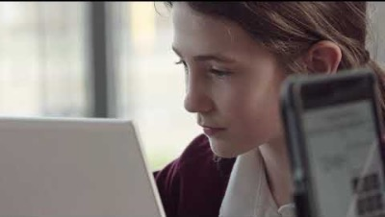
Year 4 MTC
Year 4 Multiplication tables check (MTC)
The multiplication tables check (MTC) is statutory for primary school children in Year 4.
There will be an MTC presentation on Wednesday 27th January 2027 where I will share even further details.
Schools will have a 3-week check window in June to administer the MTC. Teachers will have the flexibility to administer the check to individual pupils, small groups or a whole class at the same time.
https://www.gov.uk/government/collections/multiplication-tables-check
Notes:
Specific year group info
e.G
The purpose of the MTC is to determine whether pupils can recall their times tables fluently, which is essential for future success in mathematics. It will help schools to identify pupils who have not yet mastered their times tables, so that additional support can be provided.
Please check the following website for more information.
There will be a separate presentation on this closer to the time with all the information, Dates for this will be shared.

Slide 7
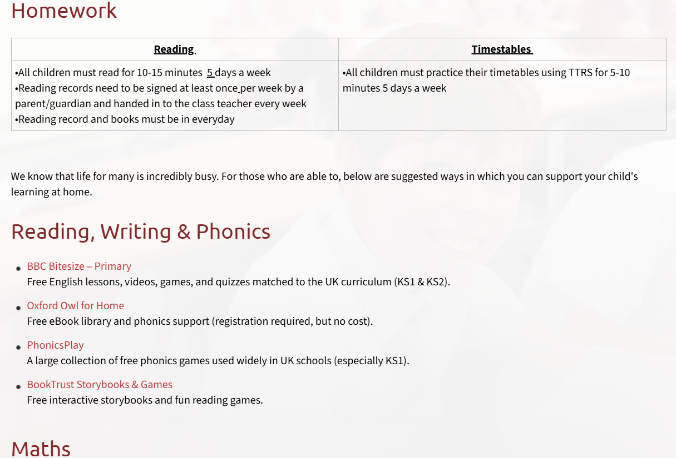
Homework
Reading | Timestables | Spelling
All children must read for 10-15 minutes 5 days a week. Reading records need to be signed at least once per week by a parent/guardian and handed in to the class teacher every week on ….. Reading record and books must be in everyday. | All children must practice their timetables using TTRS for 5-10 minutes 5 days a week. | Every Monday spelling words will be sent home in their homework books. These will be collected every Monday to be checked and the words from the previous week will be tested.
Please refer to the school website ‘Learning Resources’ page for examples of websites for further homework support
Notes:
Decide on a day to hand in reading records each week and add
Use reading record as a example
Sign post to website for more examples of homework websites

Slide 8
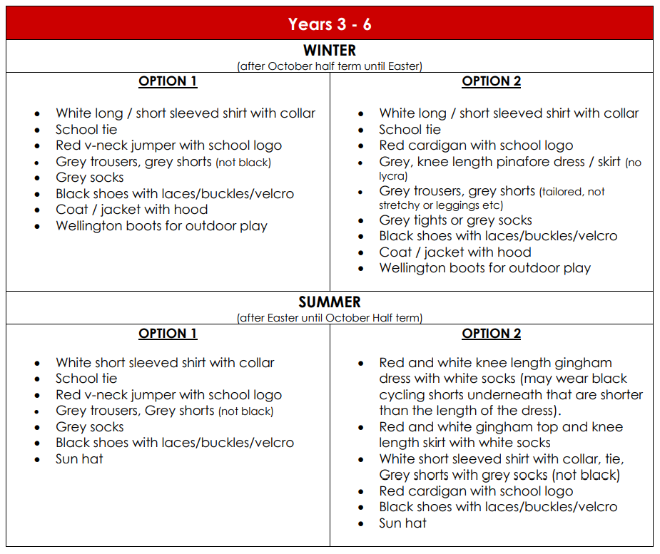
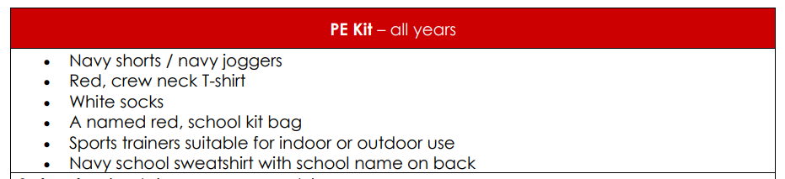
Uniform
Please refer to the school website for more information on school uniform.
Notes:
In year ________ we wear _________
PE kits consist of ______

Slide 9

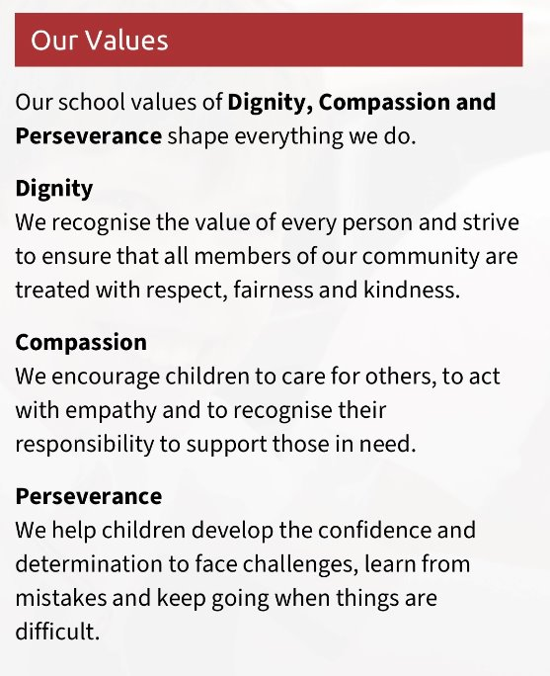
School mission and values
‘Learning to love, live and celebrate as we grow in the knowledge and love of Christ.’
Prayers to reinforce at home:
Our Father, Hail Mary, Glory Be, responses and key prayers used in Mass (Gloria, Creed etc.)
Notes:
Our mission statement – at the heart of what we endeavour to do. Showing the values we want the children to have
Treating others as we want to be treated
loving, respectful, kind, polite
Being honest
Forgiving one another
Supporting and valuing this at home
Reiterated in school through assemblies, class worship, regular links with local parishes to celebrate Mass, regular prayer.

Slide 10
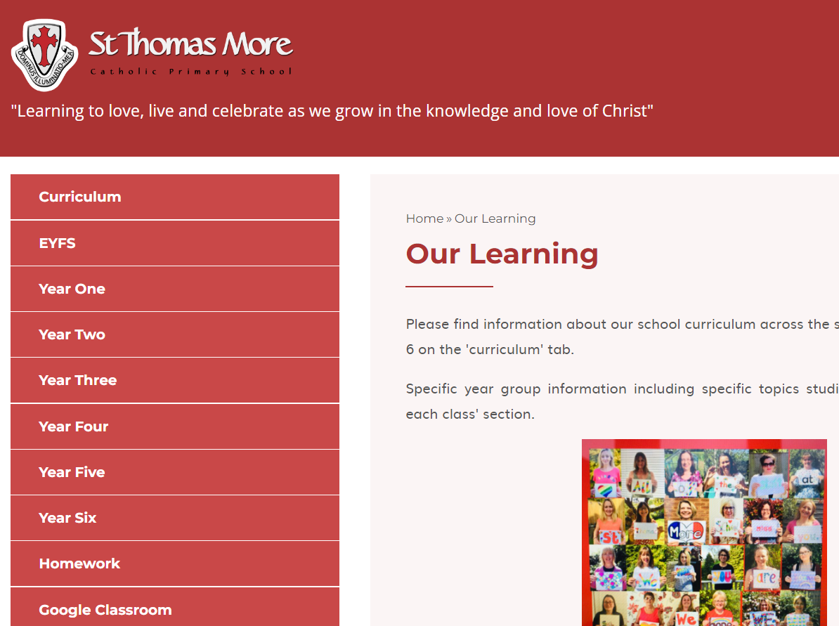
Year group class pages
Notes:
Show parents where they can find your class page on the website with overviews and class specific info should they need to refer back to it during the year

Slide 11
How to get in contact:
Email – admin@stmore.herts.sch.uk
Marvellous Me – General information, badges and achievements etc.
Drop off/pick up times 8.40am soft start (registers close at 8.50) – 3.15pm
Upcoming Important Dates:
Parent Consultation evenings – 14th and 15th October
Learning Showcase – 20th October

Slide 12

Questions?
Feel free to ask now or speak to me afterwards

