Slide 1


Welcome to Year 3’s
Meet the Teacher
Notes:
Thank you for coming. Please make sure to tick off your child’s name and take an information pack so we know which children need information packs sent home tomorrow.

Slide 2
Meet the Year __ Team
Teacher | Teaching Assistants
Mr Brooks | Mrs Morgan Mrs Sajid
Notes:
Here is some key year 4 information. The year ____ staff consist of me, ________ as the full time class teacher. ____________ and _________ are our teaching assistants in the ___________.

Slide 3
Key Information
Registration | Lesson 1 | Lesson 2 | Break | Lesson 3 | Lunch | Lesson 4 | Lesson 5 | End of the day
8:40am Soft start | Guided Reading/Spelling | English | 10:30-10:45am | Maths | 12-1pm | RE | Science | Story/end of day prayer 3:15pm
PE Days | Forest School | Swimming
Mondays and Thursdays | 21st September | Spring Term
Notes:
This is an overview of our school times throughout the day and here is an example timetable, as you can see – school days are very busy so it is no surprise very tired children come home! Our PE days this half term are _____________.
Forest School dates for the year are _______
Swimming term ____________

Slide 4
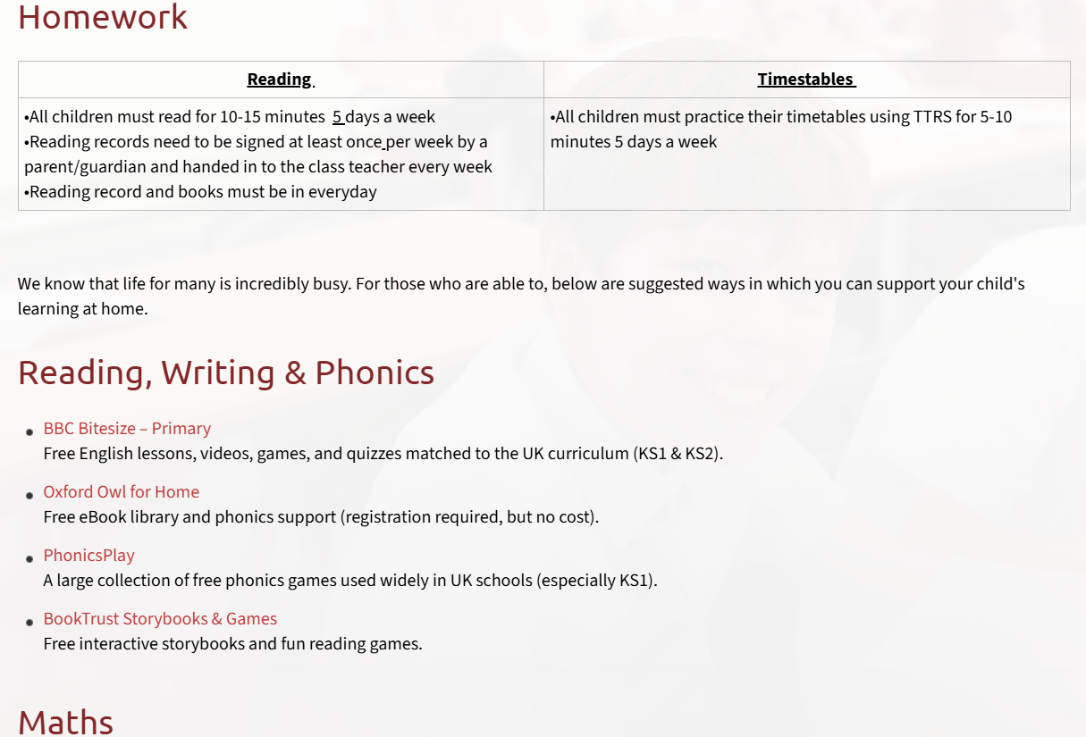
Homework
Reading | Timestables
All children must read for 10-15 minutes 5 days a week Reading records need to be signed at least once per week by a parent/guardian and handed in to the class teacher every week on ….. Reading record and books must be in everyday | All children must practice their timetables using TTRS for 5-10 minutes 5 days a week
Please refer to the school website ‘Learning Resources’ page for examples of websites for further homework support
Notes:
Decide on a day to hand in reading records each week and add
Use reading record as a example
Sign post to website for more examples of homework websites

Slide 5
Curriculum
Subject area | Autumn | Spring | Summer
English | Library Lion (Fiction) Autumn is Here (Poetry) Skeletons & Muscles (Non-Fiction) | The Incredible Book Eating Boy (Fiction) Earthquakes (Non-Fiction) I Asked The Little Boy Who Couldn’t See (Poetry) The True Story of the 3 Little Pigs (Fiction) My Strong Mind (Non-Fiction) | George’s Marvellous Medicine (Fiction) How A Robot Dog Works (Non-Fiction) The Blue Umbrella (Fiction) Light & Dark (Non-Fiction) Theseus & The Minotaur (Fiction)
Maths | Place Value Addition and Subtraction Multiplication and Division A | Multiplication and Division B Length and Perimeter Fractions A Mass and Capacity | Fractions B Money Time Shape Statistics
RE | Creation & Covenant / Prophecy & Promise | Galilee to Jerusalem / Desert to Garden | To the ends of the Earth / Dialogue & Encounter
Science | Rocks / Animals including Humans | Forces and Magnets | Plants / Light
Notes:
Here is an overview of things we will be studying in class this term Autumn 1 term.
If you want to know for the following terms, please check our subject curriculum map overviews on the school website.

Slide 6
Curriculum
th | Autumn | Spring | Summer
History | British History 1 - Would you have preferred to live in the Stone, Bronze or Iron Age? | British History 2 - Why did the Romans invade & settle in Britain? | What did the ancient Egyptians believe?
PE | Fundamentals / Ball Skills / Netball / Fitness | Swimming / Dodgeball / Dance | Athletics / Cricket / Rugby / Gymnastics
Computing | Computing systems & networks – Connecting computers Creating media – Stop-frame animation | Programming A – Sequencing sounds Data & Information – Branching databases | Creating media – Desktop publishing Programming B – Events and actions in programs
Notes:
Here is an overview of things we will be studying in class this term Autumn 1 term.
If you want to know for the following terms, please check our subject curriculum map overviews on the school website.

Slide 7
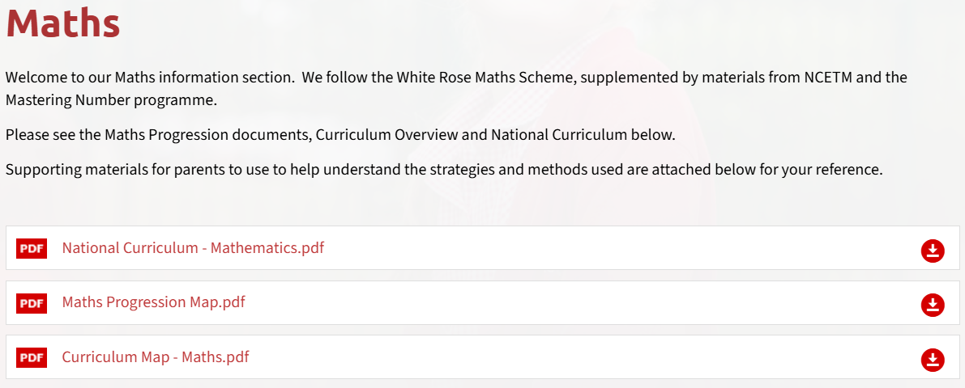
Curriculum
Subject area | Autumn | Spring | Summer
Geography | Why do people live near volcanoes? | Who lives in Antarctica? | Are all settlements the same?
Music | Recorder Lessons
Art and Design | Developing drawing skills | Prehistoric Painting | Ancient Egyptian Scrolls
Design and Technology | Pneumatic Toys | Electrical Poster | Eating Seasonally
French | I am learning French Animals | Seasons Instruments | Little Red Riding Hood Shapes
Please check our subject curriculum maps for termly topics
E.g.
Notes:
Here is an overview of things we will be studying in class this term Autumn 1 term.
If you want to know for the following terms, please check our subject curriculum map overviews on the school website.

Slide 8

Enrichment opportunities
- Drama Club
- Cartooning club
- Chess Club
Notes:
Enrichment in Year _____ is………………….
Trips, competitions etc..that you know ARE happening. – E.G. Y5& 6 RESIDENTIAL,

Slide 9
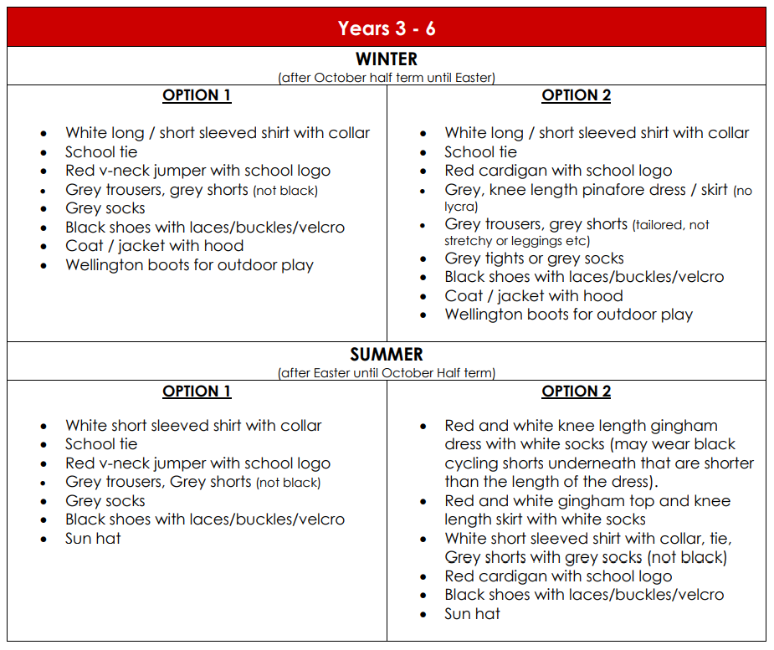
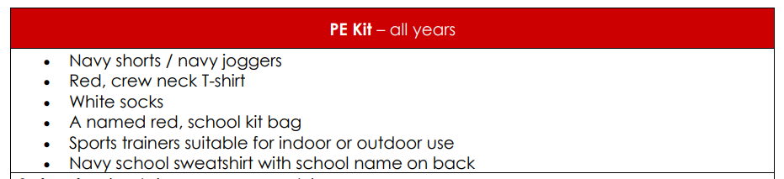
Uniform
Please refer to the school website for more information on school uniform.
Notes:
In year ________ we wear _________
PE kits consist of ______

Slide 10

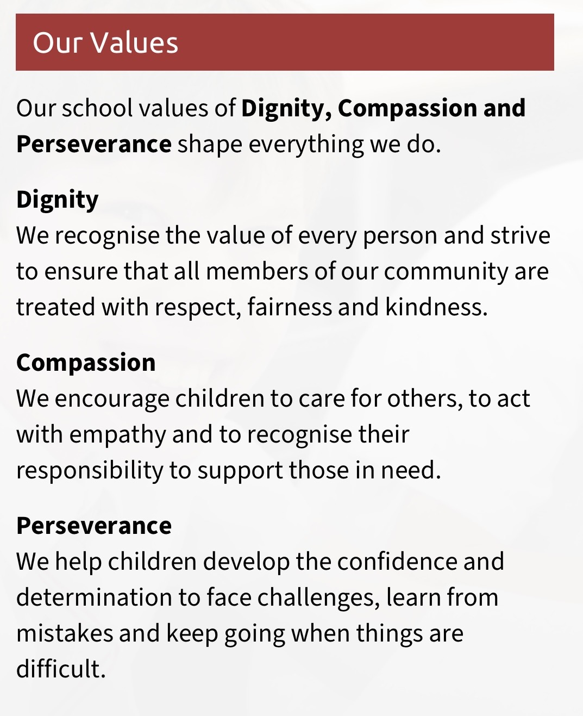
School mission and values
‘Learning to love, live and celebrate as we grow in the knowledge and love of Christ.’
Prayers to reinforce at home:
Our Father, Hail Mary, Glory Be, responses and key prayers used in Mass (Gloria, Creed etc.)
Notes:
Our mission statement – at the heart of what we endeavour to do. Showing the values we want the children to have
Treating others as we want to be treated
loving, respectful, kind, polite
Being honest
Forgiving one another
Supporting and valuing this at home
Reiterated in school through assemblies, class worship, regular links with local parishes to celebrate Mass, regular prayer.

Slide 11
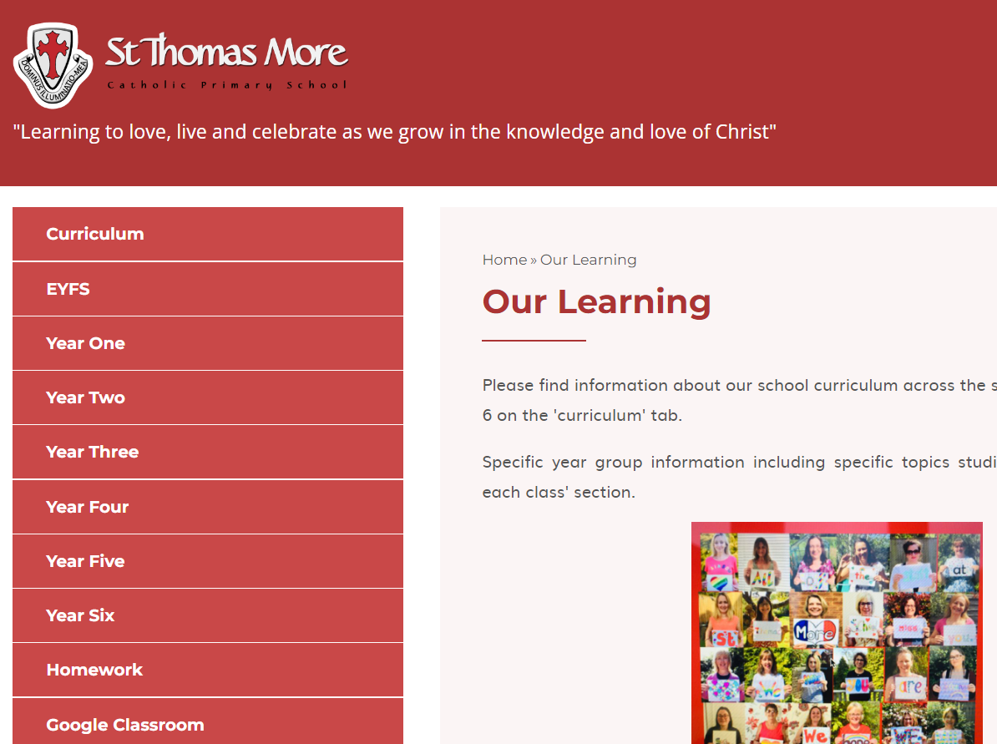
Year group class pages
Notes:
Show parents where they can find your class page on the website with overviews and class specific info should they need to refer back to it during the year

Slide 12
How to get in contact:
Email – admin@stmore.herts.sch.uk
Marvellous Me – General information, badges and achievements etc.
Drop off/pick up times
Upcoming Important Dates:
Parent Consultation evenings – Wednesday 14th and Thursday 15th October
Learning Showcase – Tuesday 20th October from 3.30pm

Slide 13

Questions?
Feel free to ask now or speak to me afterwards

